Slide 1
BalloonSat Testing
Verifying BalloonSats will function properly during a near space mission
L. Paul Verhage
8 July 2013

Slide 2
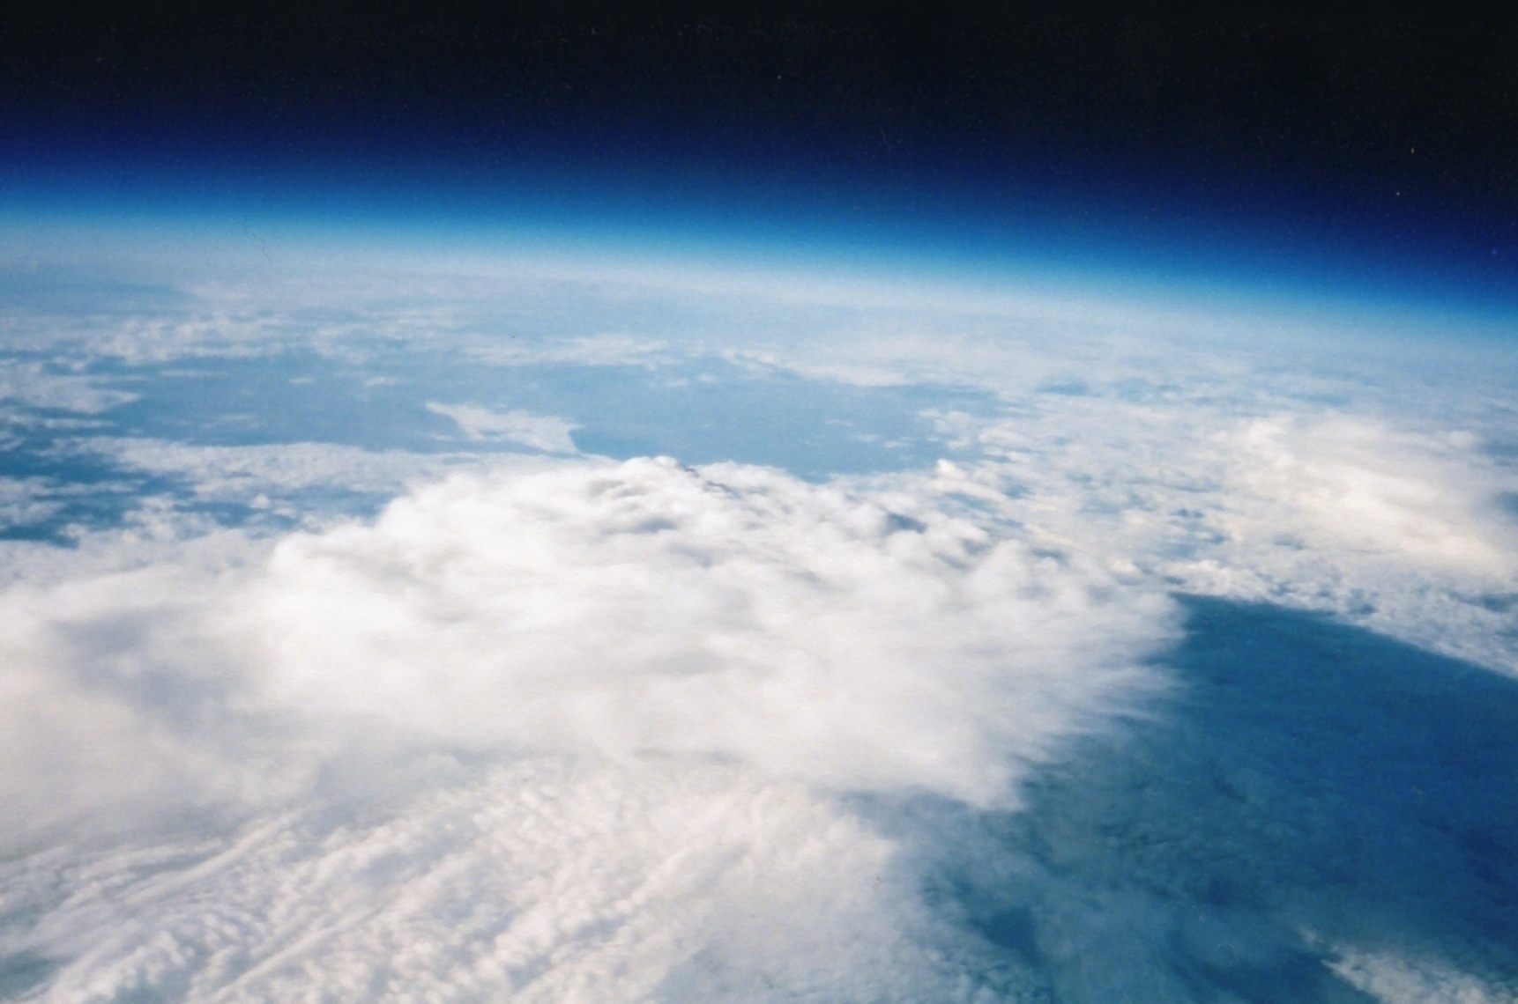
Near Space is a Hostile Environment
Intense Cold
Extreme Shaking
High Vacuum
Increased Radiation
Notes:
Completed BalloonSats need to be tested because they are entering a hostile environment where no one is present to correct them if they should fail.
In order of severity, BalloonSats must face the following challenges to their proper functioning.
It gets intensely cold in near space. Almost as cold as Antarctica
At lift off the BalloonSat experiences a great deal of shaking. At balloon burst conditions are much worse.
The air pressure approaches a high vacuum conditions in near space
The cosmic ray flux increases as BalloonSats climb the majority of the air

Slide 3
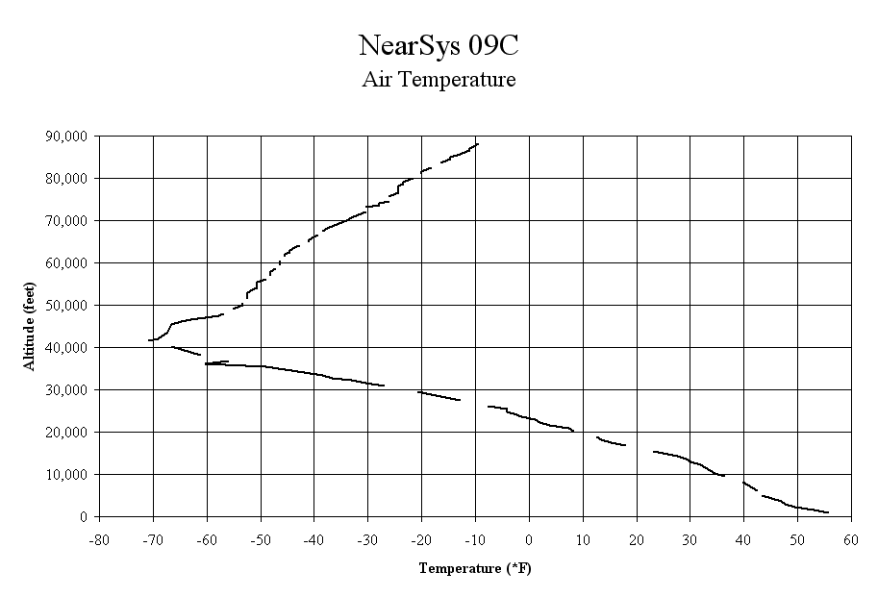
Notes:
The air temperature is lowest in the tropopause, the boundary between the troposphere and the stratosphere. In summer time and at mid latitudes, the temperature is typically -60 degrees Fahrenheit. The air temperature gets colder in winter and the higher the latitude. Temperatures of -90 degrees Fahrenheit can be expected.
Items designed for above zero degree temperatures may fail in near space. The rate of chemical reaction slows with decreasing temperature and this may adversely affect batteries. .

Slide 4
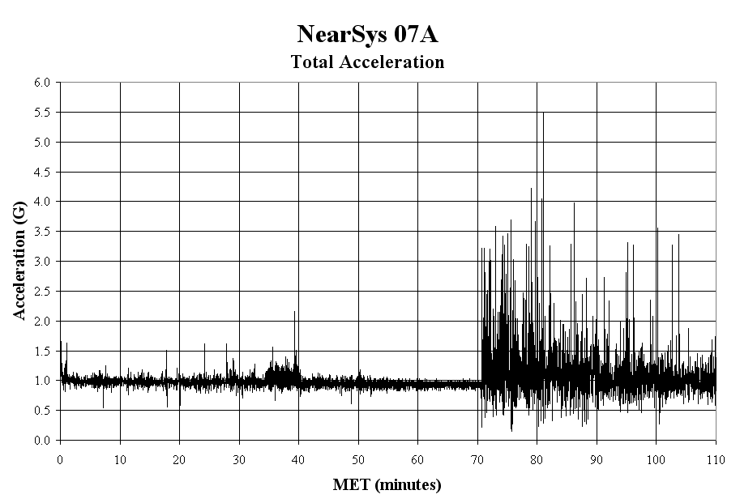
Notes:
Launch can be pretty traumatic, but balloon burst is far worse. Even though the parachute is opened, the air pressure is so low in near space that BalloonSats nearly enter in freefall. Add to that BalloonSat tumbling and shock from the parachute opening and closing and pulling sideways.
Items requiring alignment, like cameras peering out of the BalloonSat airframe, can fail after being shaken too much. Worse, the amount of shaking can become so great that parts break free from the BalloonSat.

Slide 5
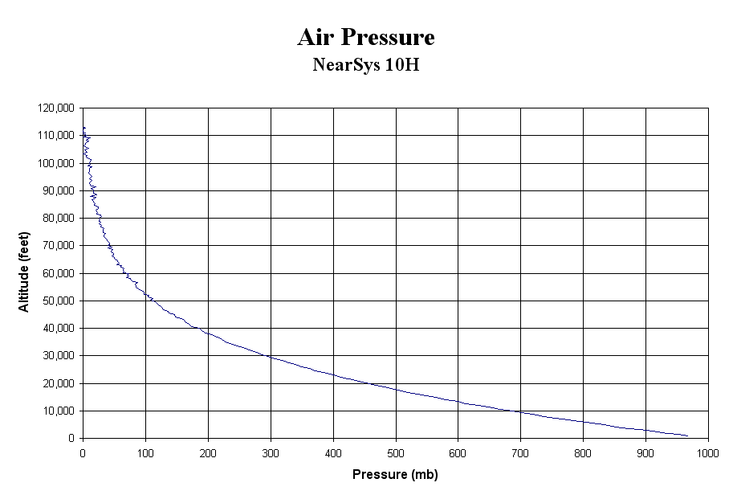
Notes:
Gravity pulls the molecules of nitrogen and oxygen towards the surface of Earth. As a result, a BalloonSat climbs above 50% of the atmosphere at an altitude of 18,000 feet. This is a small amount for a weather balloon which typically rises to an altitude of 85,000 feet or higher. Conditions can approach to 99% vacuum in during near space flights.
Items that depend on the presence of air may fail in near space. This includes instrumewnts that are air-cooled and capacitors which may arc across leads.

Slide 6
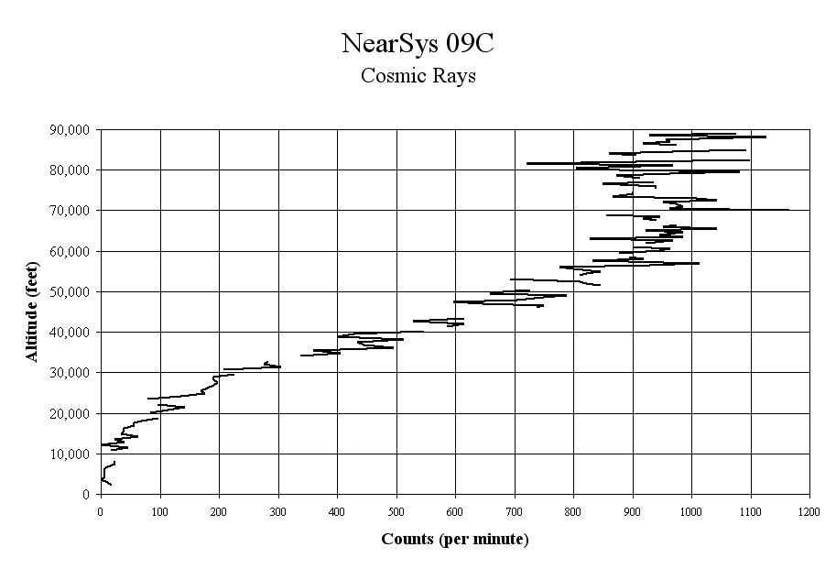
Notes:
Cosmic rays originate from the sun, stars, supernovae explosions, and possibly black holes. Earth’s atmosphere protects life on the surface from exposure to DNA-damaging cosmic radiation. As a BalloonSat climbs higher, it leaves the protection of Earth’s atmosphere. Geiger counters show the count rate for cosmic radiation can increase 100 times. Above the Pfotzer Maximum (around 62,000 feet), the count decreases. However, the average energy in each cosmic ray increases.
There is no known risk for short duration exposures to cosmic rays in near space.

Slide 7
Recommended Tests
Weight Test
Function Test
Shake Test
Cold Test
Drop Test
Notes:
The following five BalloonSat tests are recommended. They are listed in order of importance.

Slide 8
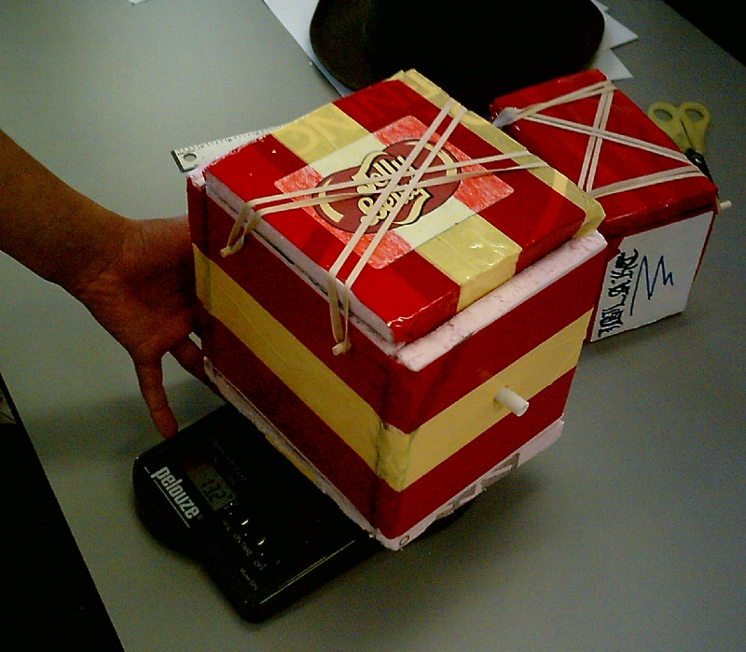
Weight Test
Is the BalloonSat within weight limits
Notes:
Purpose
The Weight Test verifies that the BalloonSat is not too heavy. FAR 101 limits balloon flights to 12 pounds if they are not exempt. In order to simplify near space launches, BalloonSats are usually given weight limits.
Procedure
Add the battery and any other experiment or item the BalloonSat is suppose to carry. Weigh the complete BalloonSat on a scale and verify that it is not over weight.

Slide 9
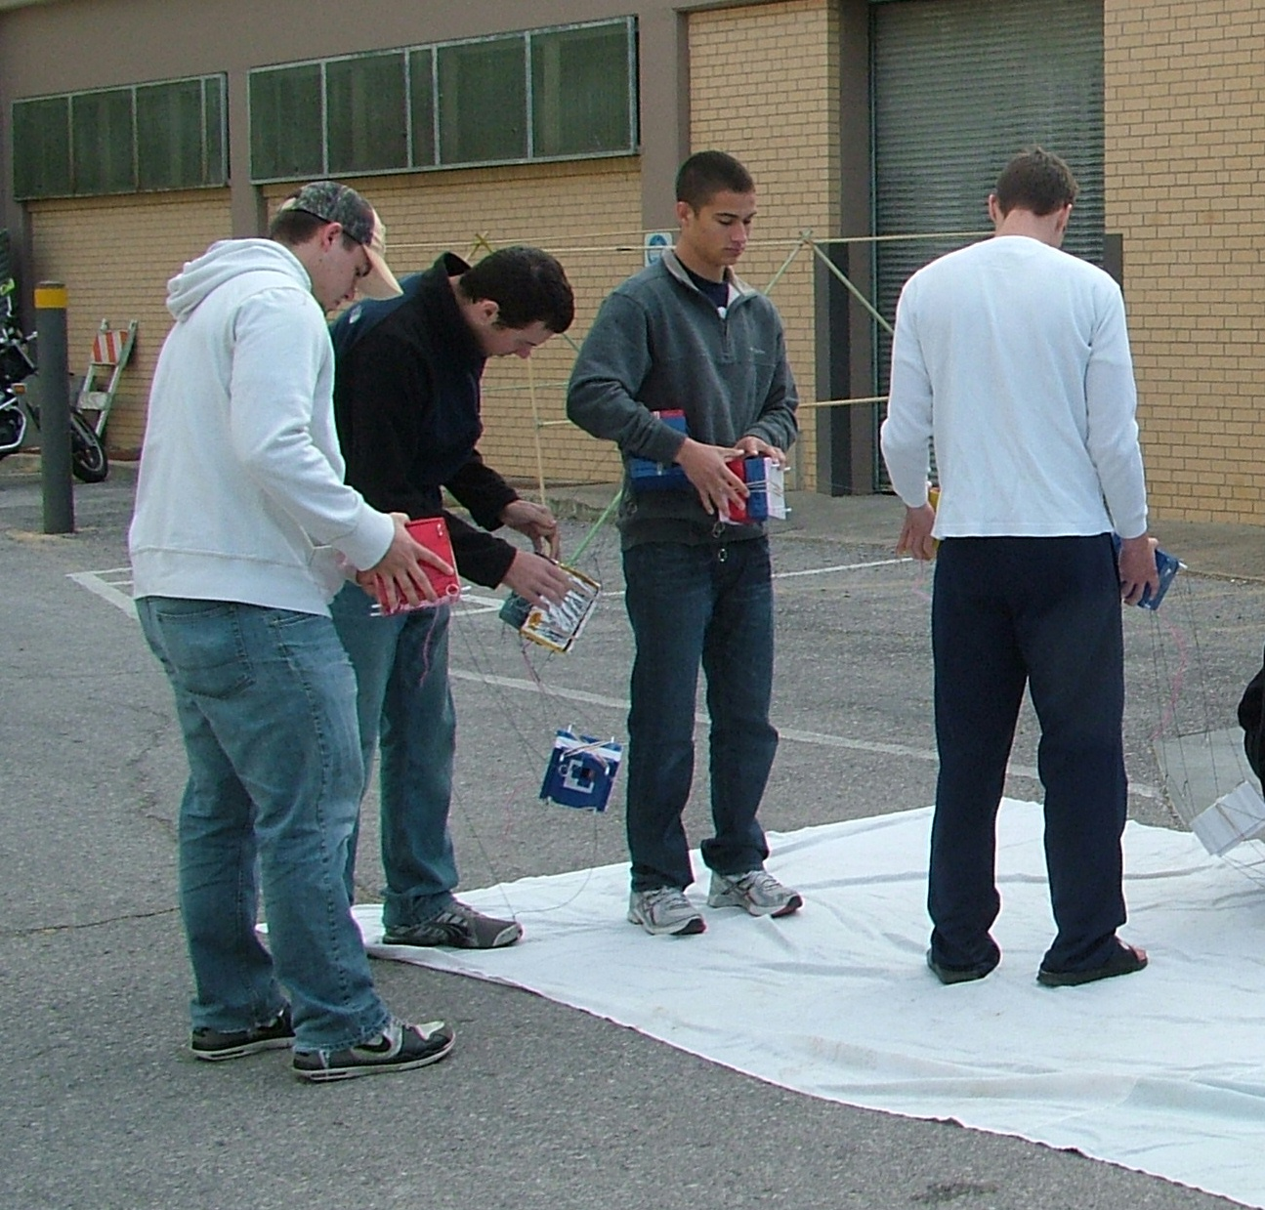
Function Test
Does the BalloonSat start easily and does it collect data as designed
Notes:
Purpose
The Function Test verifies that a launch crew can start their BalloonSat and that the BalloonSat will operate by collecting data and recording images for the length of a near space mission.
Procedure
Remove the battery from the BalloonSat. Also remove any experiments that will be loaded on the morning of the launch. Time the BalloonSat crew while they prep their BalloonSat for its mission. This includes opening the BalloonSat, installing the battery and other possible experiments, and closing the BalloonSat back up. The time required should not be excessive or else it may delay the launch. Take into consideration that if the launch takes place on a cold morning, launch crews may need to remove their gloves and may suffer form stiff fingers. If gloves are not to be removed, then make sure the BalloonSat can be prepped while wearing gloves.
Then have the BalloonSat crew start their BalloonSat recording data. This should be very quick, as the BalloonSat should record as little data as possible on the ground. If the camera or instrument onboard the BalloonSat has a power save feature that cannot be turned off, then make sure it can be turned quickly at launch time.
Now let the BalloonSat sit and collect data and operate experiments for at least 90 minutes. Longer if the BalloonSat is designed to collect data during descent.
After completing the test mission, verify the BalloonSat crew can download and save their data for analysis.

Slide 10
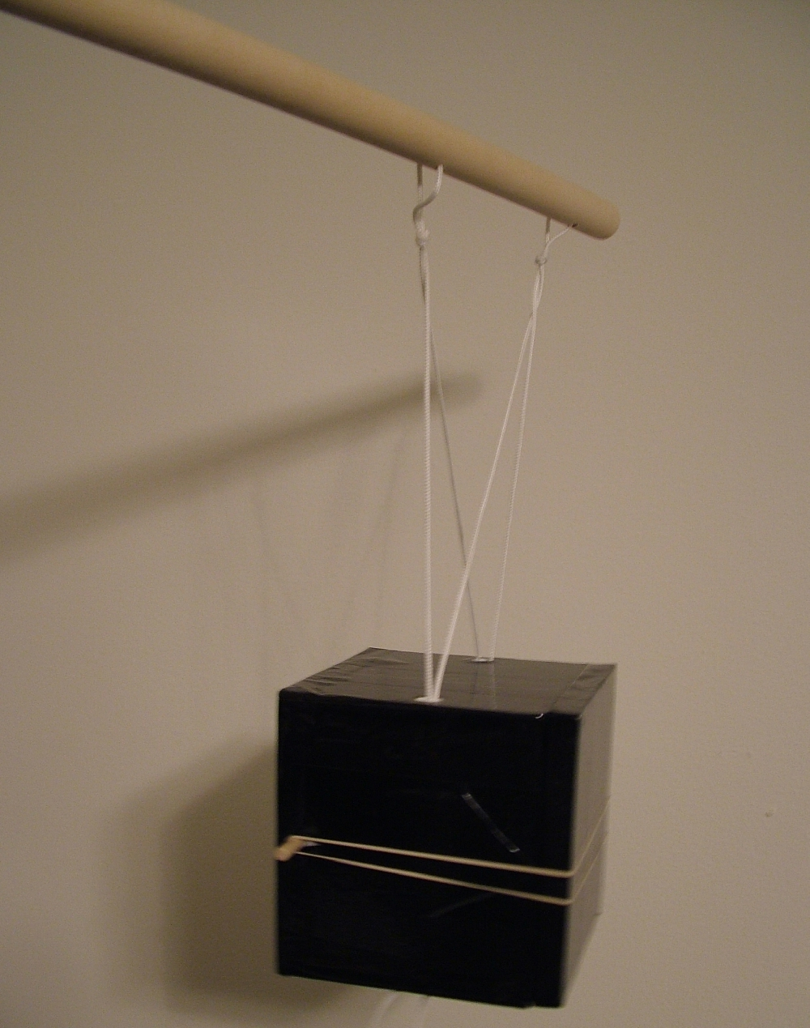
Shake Test
Does the BalloonSat hold together during shaking
Notes:
Purpose
The Shake Test verifies that parts do not break free of the BalloonSat or do not move out of proper alignment due to shaking. The amount of shaking at balloon burst can be very intense.
Procedure
Install the battery and any other items the BalloonSat is to carry. Run a series of tether lines through the BalloonSat and attach the ends of the tethers to a stick. The stick should be around a meter long so the person performing the test is not injured by the BalloonSat.
Now shake the stick and bounce the BalloonSat around. Be careful and do not let the BalloonSat bang into a wall or person. Shake the BalloonSat vigorously for a minute or two. The BalloonSat should not lose items, the hatch should not come loose, and items inside, like cameras, should not lose alignment with their lens holes.

Slide 11
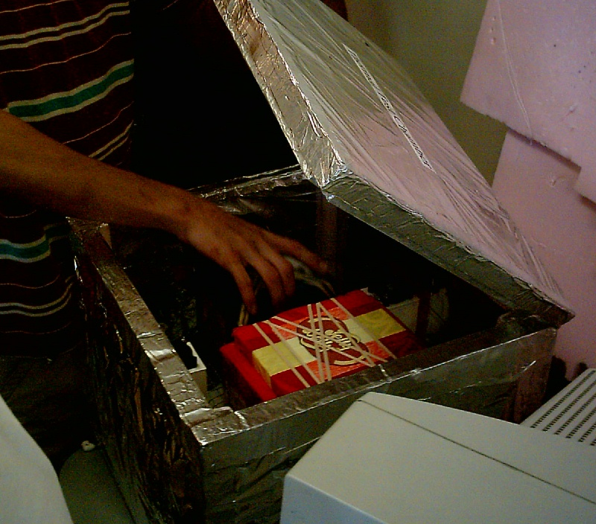
Cold Test
Does the BalloonSat continue to function when extremely cold
Notes:
Purpose
The Cold Test verifies that the BalloonSat can operate properly when it is extremely cold.
Procedure
Load the battery into the BalloonSat. If desired, start a hand warmer and let it warm the interior of the BalloonSat prior to the test. Load a Styrofoam cooler with dry ice and let its interior get very cold. Place a wire stand over the dry ice so that the BalloonSat will not make contact with the dry ice when it is placed inside the cooler.
Start the BalloonSat recording data and load place it inside the cooler. Close the cooler lid and let the BalloonSat cold soak for about 30 minutes. The BalloonSat should collect data during the Cold Test.

Slide 12
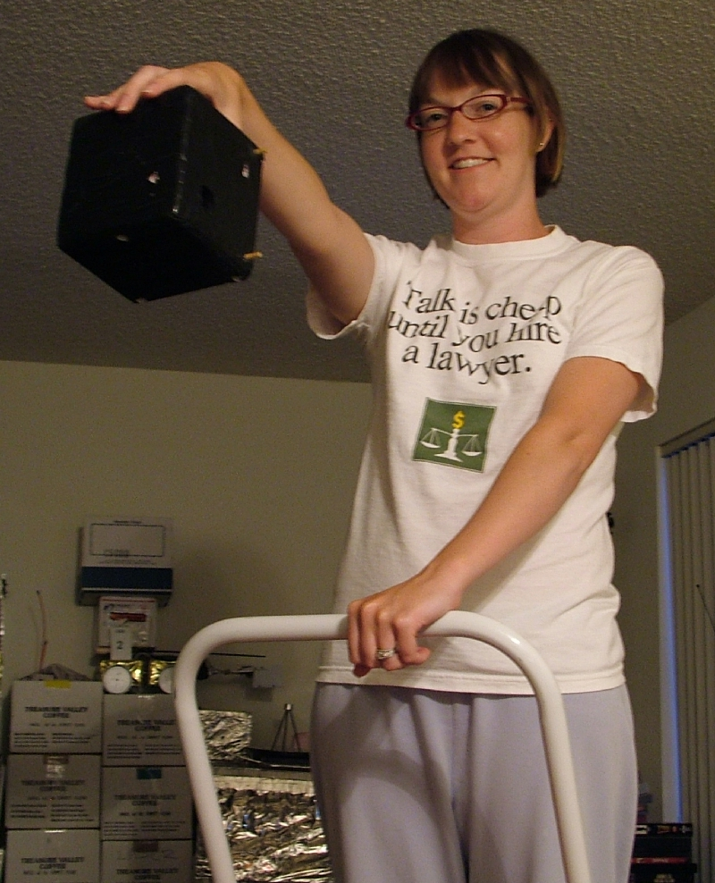
Drop Test
Does the BalloonSat hold together at landing
Notes:
Purpose
The Drop Test verifies that the BalloonSat can survive landing. If the BalloonSat passes the Shake Test, then there may be no need to perform this test.
Procedure
The landing speed of the near spacecraft is approximately 10 mph, that’s about 15 feet per second. Gravity creates this speed when an object has fallen four feet.
Load the BalloonSat with its battery and any other item it is designed to carry. Then drop the BalloonSat form a height of four feet on to a carpeted or grassy surface. Chances are likely that the BalloonSat will not land on concrete, so there’s no need to test falling onto this type of surface. Verify that the BalloonSat holds together after the shock of impact with the ground. Items being knocked out of alignment are not a concern since the BalloonSat has generally completed its mission when it lands.

